Slide 1
Boron Neutron Capture Therapy Implementation at Research Reactor: Physical and Biological Aspects
DR. NORFARIZAN BINTI MOHD SAID
Research Officer
Reactor Technology Centre, Malaysian Nuclear Agency

Slide 2
PRESENTATION OUTLINE
Introduction
Boron Neutron Capture Therapy Implementation at Research Reactor
Physical Aspects
Biological Aspects
Conclusion

Slide 3
Introduction
Boron Neutron Capture Therapy (BNCT) is a promising cancer treatment modality that utilizes thermal neutrons to induce tumor cell death in less toxic environment.
Research reactor is one of the reliable neutron sources for BNCT implementation.
This review will focus on the physical and biological aspects of BNCT implementation at research reactor.
The aim is to propose REAKTOR TRIGA PUSPATI (RTP) as a neutron source for BNCT procedure.

Slide 4
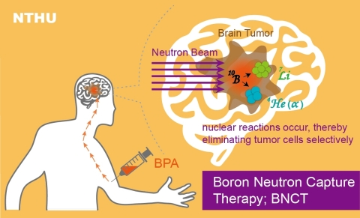
Principles of BNCT: Based on nuclear capture and fission reactions
Graphic: National Tsing Hua University
A beam of low energy neutrons penetrates the brain tissue, reaching the malignancy.
The low energy neutrons combine with boron-10 to form boron-11
High energy radiation (Lithium ions and alpha particles) released able to kill the tumor.

Slide 5
Benefits of BNCT
Good targeting and little damage to the surrounding healthy tissues
Efficacy even for solid tumors affected by hypoxia
Irreversible local cellular damage
Use of essential element (B) for human, animal, and plant health that can be combined with variety carriers
Higher penetration of neutrons is possible advantage over other forms of particle therapy such as ion & proton
Low cost of neutrons
(Ref: Belchior et al., 2022; Dymova et al., 2020; Jain,K.K., 2018)

Slide 6
Challenges in BNCT
Selective accumulation in cancer cells of boron containing agents and the delivery of therapeutic boron levels with minimal normal tissue toxicity (Belchior et al., 2022).
Successful BNCT needs (Moss et al., 1997):
1) Sufficient Boron-10 in each tumor cell with low concentration in
healthy tissue
2) Sufficient thermal neutrons delivered to each of boronated cells
3) Suitable neutron source

Slide 7
Physical Aspects
Neutron Source
Neutron Beam
Facility Design
Biological Aspects
Boron
Biological Effects
Neutron
REVIEW

Slide 8
REACTOR-BASED NEUTRON SOURCE FOR BNCT
NEUTRON SOURCE
TYPE | ADVANTAGES | DISADVANTAGES
Existing reactors with large irradiation facility such as thermal column | Spectrum shifting High flux-to-power ratio | Separated from hospital Interferes other utilization
Existing reactors having only narrow and long beam tubes | Filtering Low flux-to-power ratio
New conventional reactors | Adaptation of thermal column type for NCT is recommended
Dedicated new NCT reactors | In the hospital Integrated facility for NCT Sufficient flux at multiple positions Extreme safety | Difficulty with public acceptance
Thermal reactors | Partial recovery of low flux-to-power ratio by a fission converter (if possible) Availability of much experience | Low flux-to-power ratio
Fast reactors | High flux-to-power ratio Compact facility | HEU is needed Very limited experience
IAEA-TECDOC-1223

Slide 9
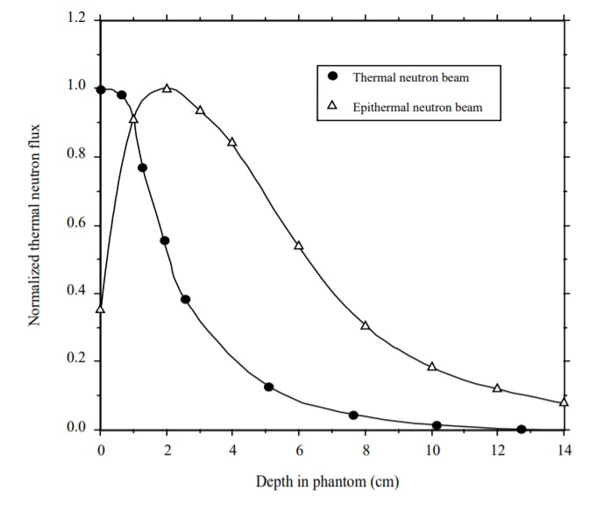
NEUTRON BEAM
1968-1997: More than 100 brain tumor patients in Japan treated using thermal neutron beams at Hitachi Training Reactor (HTR), Kyoto University Research Reactor (KURR) and Musashi Institute (Hatanaka et al.,1986; Moss et al., 1997; Kanda, 1975; Aizawa et al., 1980).
1994: Brookhaven & Massachussetts Institute of Technology (MIT) started clinical trials with epithermal neutron beams (Coderre, 1995; Madoc-Jones et al.,1995)
1997: First Europe BNCT Clinical trial with epithermal neutron beams started at High Flux Reactor (HFR) in Pettern, Netherlands (Moss et al., 2001)
Beam size: Circular apertures of 12 to 14 cm diameter, up to 17 cm proposed for brain tumors irradiation; based on tumor size and position
source IAEA-TECDOC-1223
Thermal beams - target volumes near the surface
Epithermal beams - target volumes below the surface
Depends on type of tumor to be treated
Goal: Neutron beam with enough intensity to provide therapy, minimize patient risk & discomfort, minimal contaminations from fast neutron and gamma ray.

Slide 10
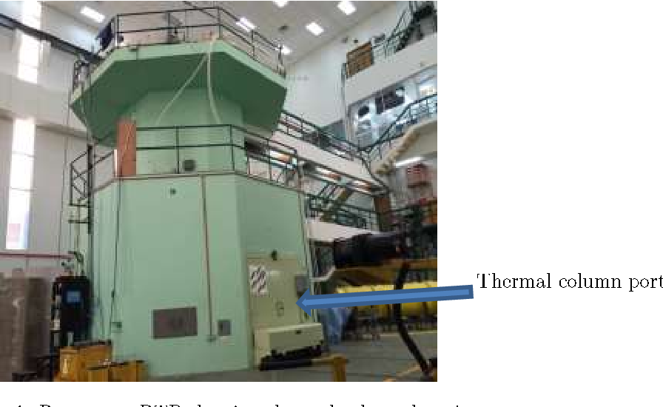
FACILITY DESIGN
General purpose RR modified for NCT with 2 basic methods:
Spectrum shifting
Filtering
Moderate the fast neutrons from the core to appropriate lower energy
Suitable for large aperture irradiation facility such as thermal column
Transmits neutrons of desired energy while blocking others
Suitable for reactor with narrow and long beam tube
Modification/Arrangement: Remove reflector, spectrum shifting, fit all beam-conditioning components (fission converter, moderator, filters, collimators, and shutters) with the objective of shortest distance from core to patient, vehicle accessibility without compromising the radiological safety and physical security, patient treatment area meet medical facilities standards.

Slide 11
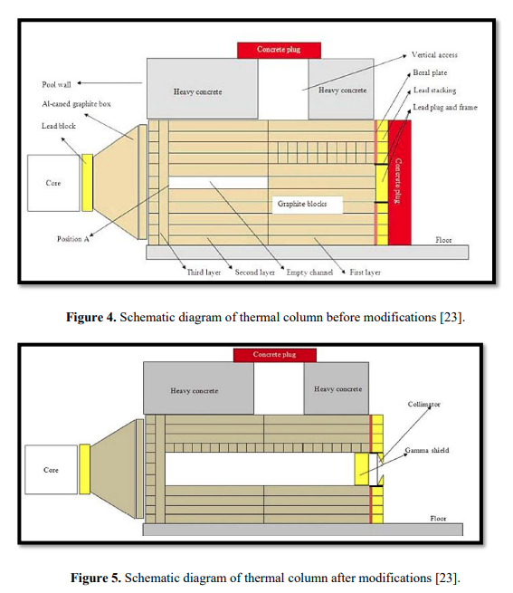
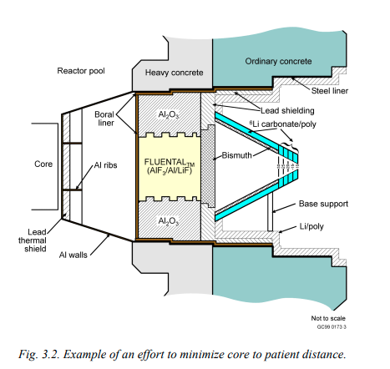
Source: IAEA-TECDOC-1223
Source: S. Shalbi et al., 2020; Kasesaz et al., 2016

Slide 12
Physical Aspects
Neutron Source
Neutron Beam
Facility Design
Biological Aspects
Boron
Biological Effects
Neutron
REVIEW

Slide 13
BORON
Sufficient Boron-10 in each tumor cell needed for successful BNCT (IAEA-TECDOC-1223, 2001)
Boron-containing nucleic acids and peptides to boron-containing nanoplatforms has been subject of interest to be explored (Barth et al., 2018, Belchior et al., 2022)
1967: Boron compound sodium mercaptoundecahydrododecaborate (sodium borocaptate/BSH) developed by Soloway (Soloway et al.,1967; Moss et al., 1997)
Boronophenylalanine (BPA) (Belchior et al, 2022; Moss et al., 1997; Mishima et al., 1989)
Boronated DNA-binding compound – produce more localized lethal effect and act as fluorescent probes to follow the compound inside the cells (Ghaneolhosseini et al., 1998; Crossley et al., 2007, Cholewinski et al., 2011; Wang et al., 2016; Gao et al., 2020; Belchior et al., 2022)
Blood-brain barrier (BBB) needed for enhancing the drug delivery to brain tumors (Pardridge, 1995; Barth, 1997).
Positron Emission Tomography (PET) used for quantification of boron compound concentration for BNCT (Balcerzyk et al., 2020)

Slide 14
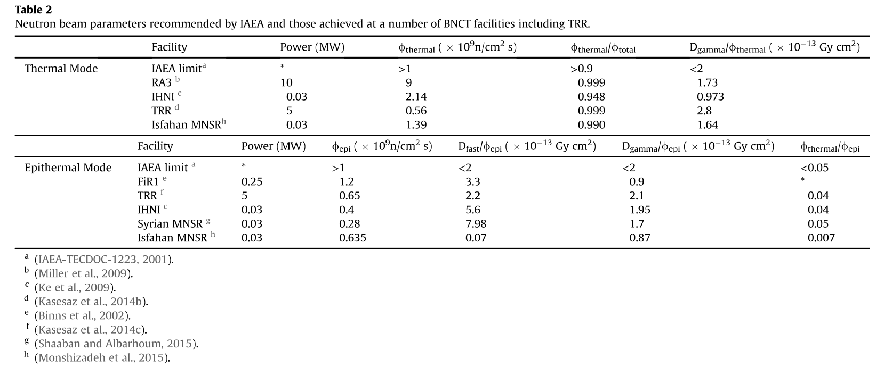
NEUTRON
Sufficient thermal neutrons delivered to each of boronated cells are needed for successful BNCT (IAEA-TECDOC-1223)
(Kasesaz et al., 2016)
Beam optimization & characterization
Coupled neutron-gamma calculation with MCNP4A/B/C (Briesmeister, 2000) and cross sections based on ENDFB6 data library, GEANT4 for doserepartition and interactions generated by low-energy neutrons
Neutron dosimetry and treatment planning need to be calculated and verified with measurement

Slide 15
BIOLOGICAL EFFECTS
Dose Components contribute to absorbed dose:
Gamma, neutron, high-LET proton, boron
Keypoints: Measurements, Calculations, Biological dosimetry
Radiobiology and pre-clinical experiment:
Early inter-comparison experiments incorporating:
- small volumes cells, cell culture, cellular viability studies
- irradiation with simple geometrical shape and appropriate material
- irradiation without boron and with two different concentrations of
boron in the form of ¹⁰B-enriched boric acid
To understand the organ response, experiments with epithermal beams would require large animals as small animals would receive a lethal whole-body dose
(IAEA-TECDOC-1223, 2001; Belchior et al., 2022)

Slide 16
Conclusion
BNCT is a complex therapy that requires interdisciplinary interaction among professionals (nuclear scientist, chemists, pharmacologists, neurologist etc)
Operation & Management
Radiotherapy and Nuclear Aspects on Quality Assurance and Safety
BNCT regarded as an investigational therapy and patients were treated in well designed phase I (toxicity) and phase II (efficacy) clinical trials. *Phase III (BNCT randomized against best current practice)

Slide 17
THANK YOU

