Slide 1



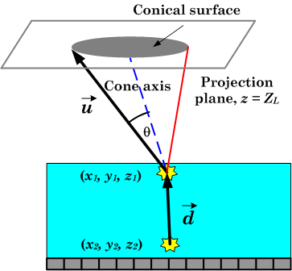
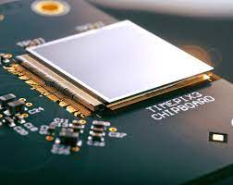
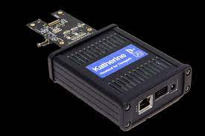
SINGLE-LAYER COMPTON CAMERA (slcc)
1 mm thick CdTe + Timepix3 ASIC
Lojius Lombigit¹, Dima Maneuski² & Benedikt Bergmann³
¹Technical Support Division, Malaysian Nuclear Agency, 43000, Kajang, Selangor
²SUPA School of Physics and Astronomy, University of Glasgow, Glasgow, G12 8QQ, United Kingdom
³Institute of Experimental and Applied Physics, CTU in Prague

Slide 2
Contents
1
Introduction
2
Kinematic of single-layer Compton camera
3
Proof of concept
4
Result
5
Conclusion

Slide 3
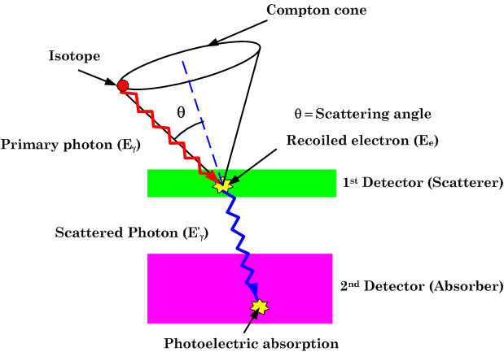
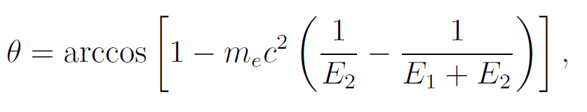
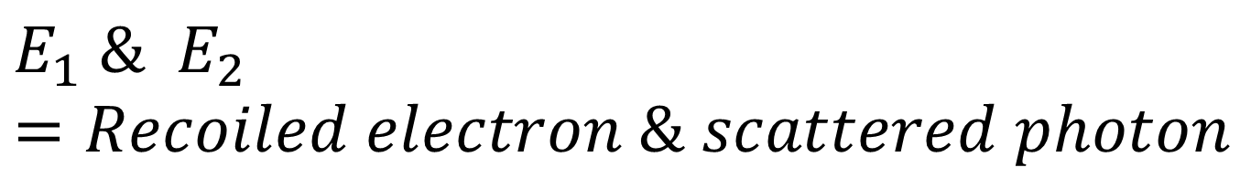
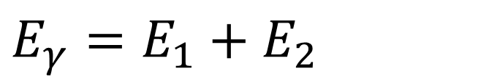
What is Compton camera?
Compton camera is a novel gamma camera concept that relies on the Compton kinematic for image reconstruction
Single-layer Compton camera (SLCC) is a single detector system where recoiled electron and scattered photon are detected on the same detector volume.
$$E_{γ}=E_{1}+E_{2}$$
$$E_{1} \& E_{2}=Recoiled electron \& scattered photon$$

Slide 4
Hybrid Pixel detector based on Timepix3 readout ASIC
2015: 130 nm CMOS
Frame-based or
Data-driven
Pixels: 256 x 256
pitch: 55 μm
Energy resolution:
< 600e- (FWHM)
ToT + ToA
ToA: 1.562 ns
ToA only
Min. detectable Charge: > 500e-
Event Count + iToT
Semiconductor detectors
(Si, GaAs, CdTe, CZT)
**ToT = Time over Threshold (Energy measurement)
** ToA = Time of Arrival (Time measurement)

Slide 5



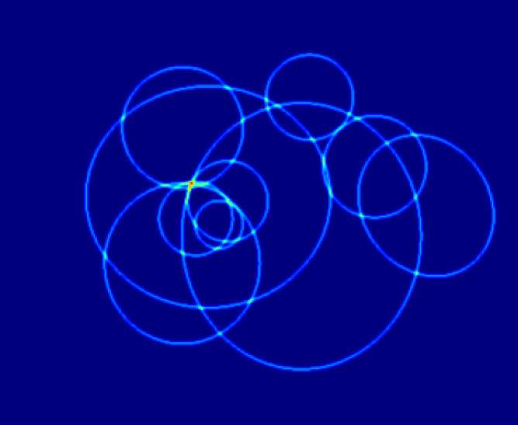
KINEMATICS of slcc

Slide 6
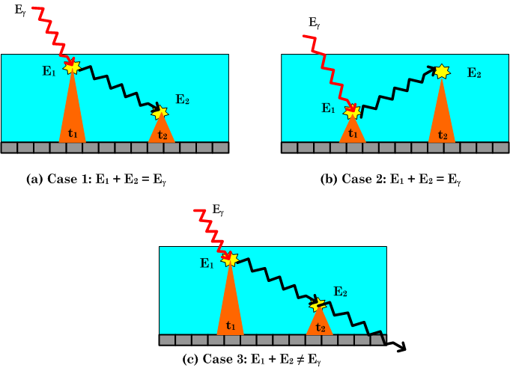
KINEMATICS of slcc
Valid event
Valid event
Invalid

Slide 7
Challenges
Selection of valid Compton events
Filtering the XRF (Cd & Te)
Finding the z-axis coordinate
Scattering Angle
Events that correspond to energy deposition of recoiled electron & scattered photon
XRF = byproduct of photoelectric.
Introduced error during image reconstruction
Pixel detectors only registered x & y pixel coordinates.
Scattering Angle that
Produced conic surface
Two events that occurred within the pre-defined clustering time.
Total energy =[E_γ ± σ]
Energy cuts:
E_recoiled ≠ [EXRF ± σ ]
3D pixel separation
Depth difference: Computed from time different between two events
Event due to recoiled electrons must be on the top.

Slide 8
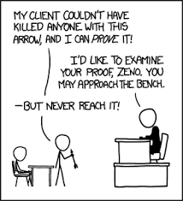
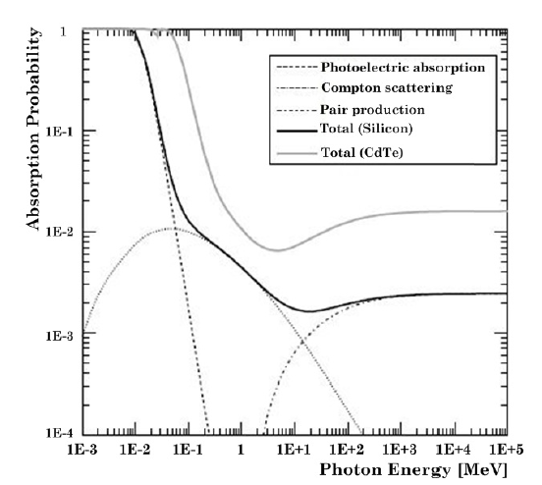
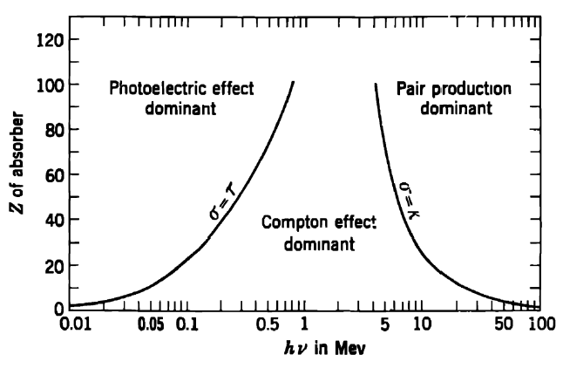
Proof of concept
D. Turecek et. Al., (JINST 2020) demonstrates SLCC on 2 mm thick CdTe with ¹³¹I (364 keV), ²²Na (511 keV) & ¹³⁷Cs (662 keV)
Tc-99m (140 keV) on thinner CdTe sensor?
E ≈ 140 keV
Z≈48

Slide 9
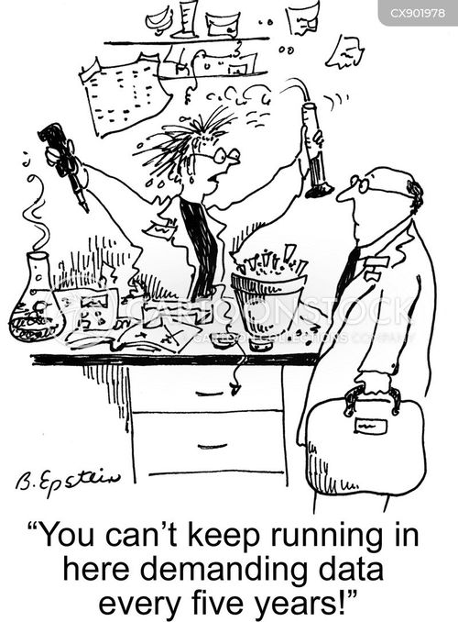
Experiment setup
Institute of Experimental & Applied Physics (IAEP) , CTU of Prague.
Detectors: 1 mm thick, 55 μm-pitch, 256 x 256 CdTe sensors + Timepix3 readout ASIC, V_{bias} = - 300 V.
Photon source: 1 MBq, ⁵⁷Co (122 keV).
Acq. time: 3600 s & 1800 s (data-driven ToT + ToA mode).
DAQ : Katherine readout & Burdamann software.
⁵⁷Co
Z_{L} ≈60 mm
50 mm
Hybrid pixel detectors (CdTe + Timepix3)

Slide 10

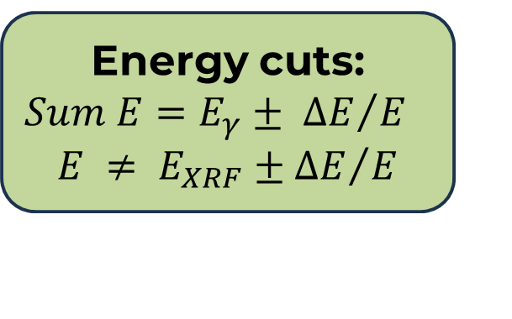
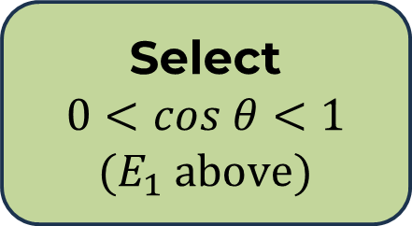

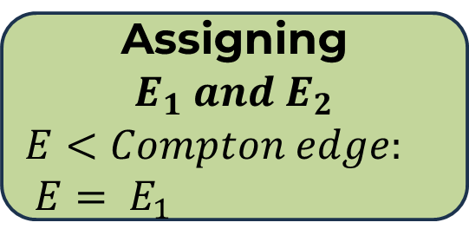
Data analysis
Clustering:
Full-length charge collection time (FLCC) ≈ 32 ns
Two Coincidence Events:
Energy cuts:
$$Sum E=E_{γ}± {∆E}/E$$
$$E ≠ E_{XRF}±{∆E}/E$$
Python 3 IDE
(Numpy, SciPy, Matplotlib, LMFIT)
Assigning $E_{1} and E_{2}$
$$E<Compton edge:$$
$$E= E_{1}$$
Image reconstruction
Select
$0<cos θ<1$ ${(E}_{1} above)$
Compute
$θ$ & $Z−coordinate$

Slide 11
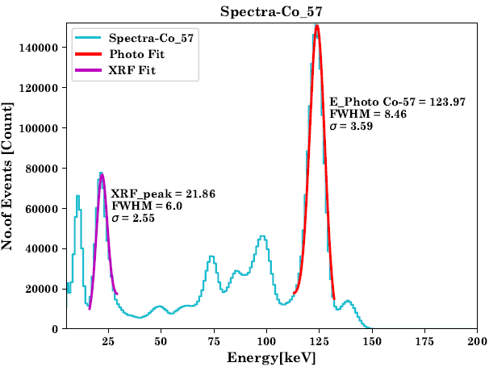

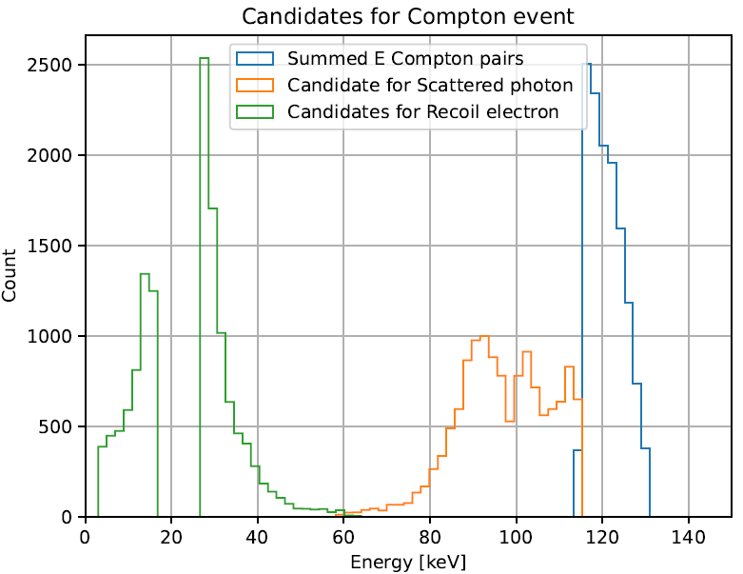
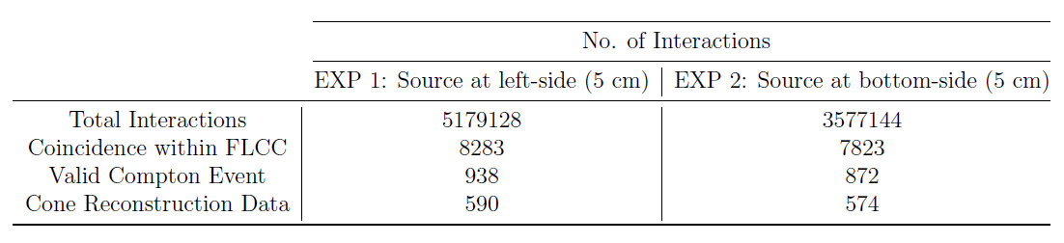
Result
Coincidence < 0.2 %
Cone reconst. Data < 8 %

Slide 12
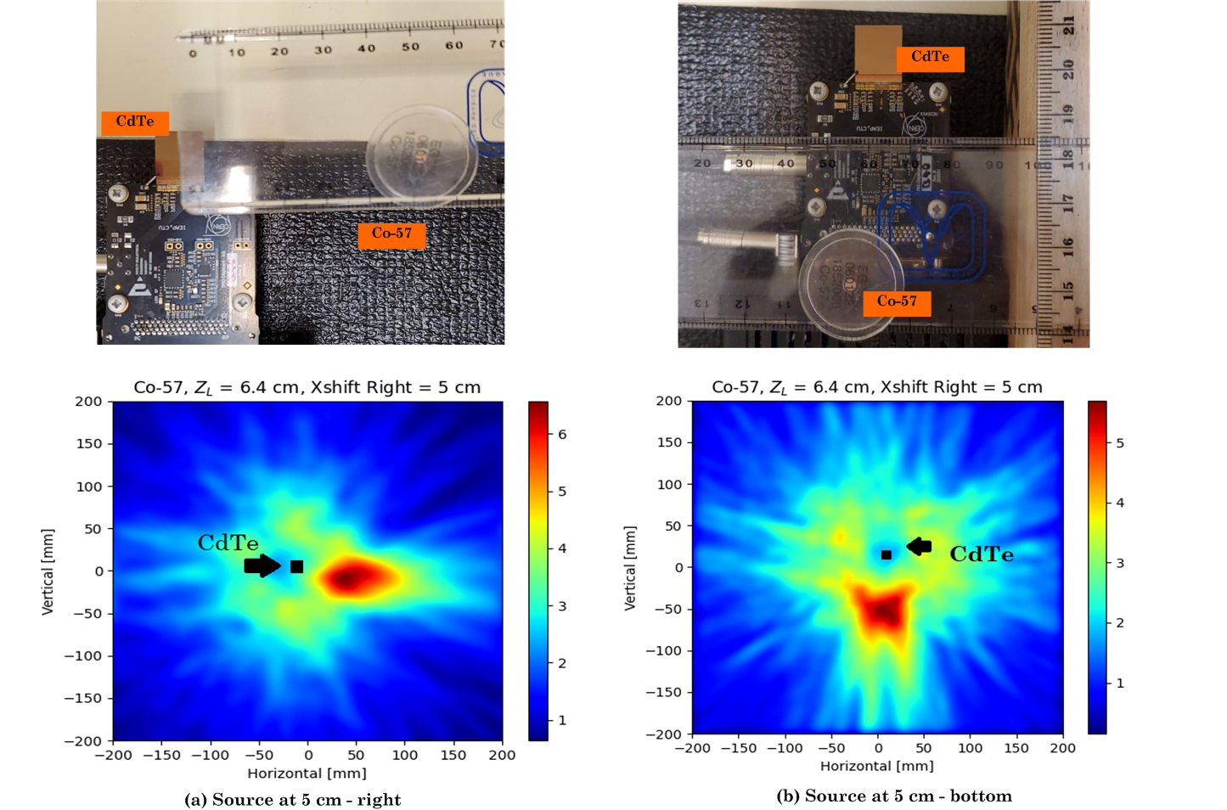
Result

Slide 13

Limited valid Compton events
Photoelectric absorption is dominant (@ 122 keV)
Detector thickness
XRF event suppression
Energy cut is insufficient
Selection by 3D pixel distance
Technology works
Timepix3 superior ToA resolution @ 1.562 ns
Simultaneous Energy (ToT) & Time (ToA) measurement
Compton event selection algorithm proven

Slide 14
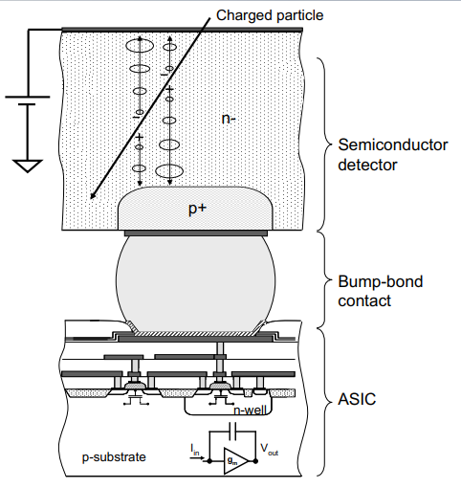
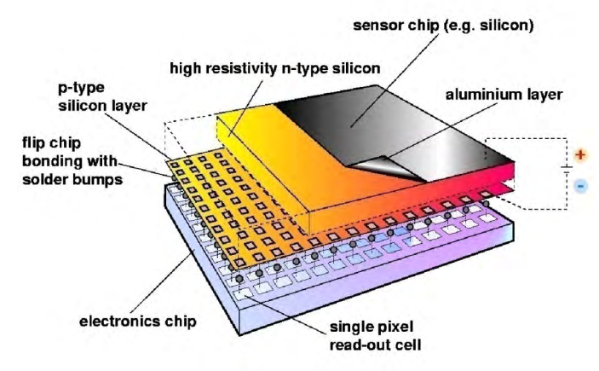

Slide 15
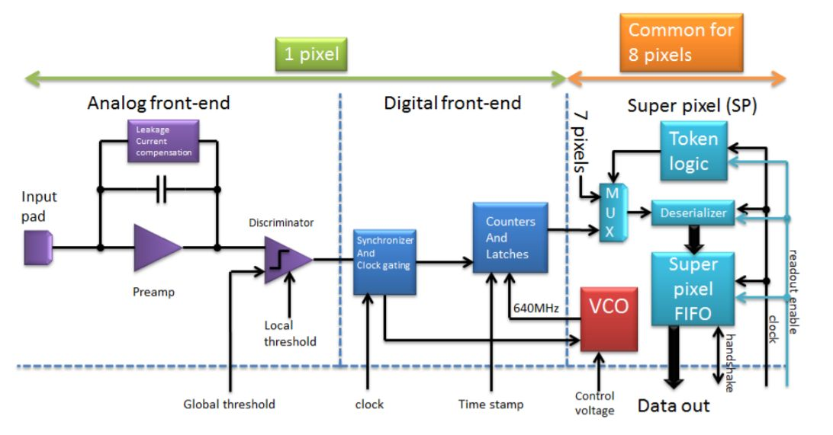

Slide 16
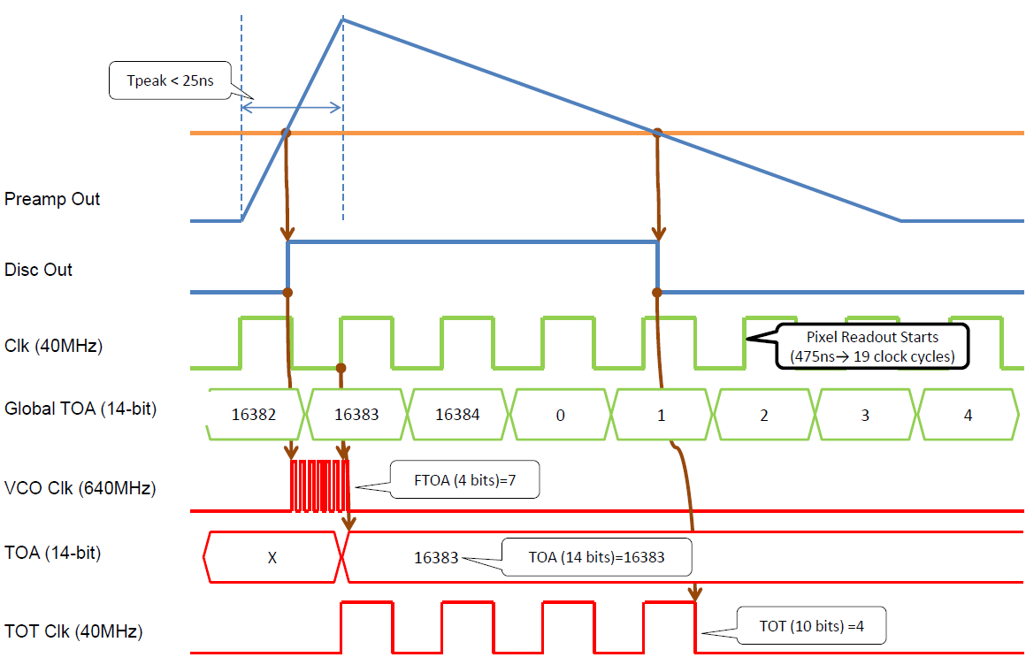

Slide 17
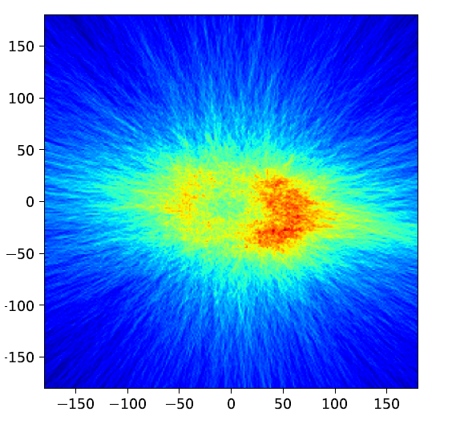
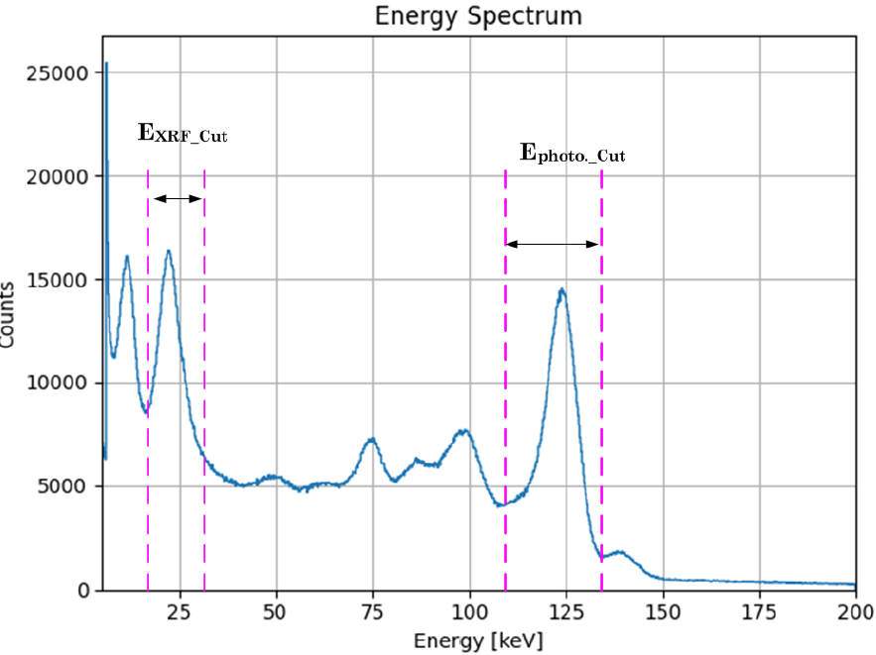
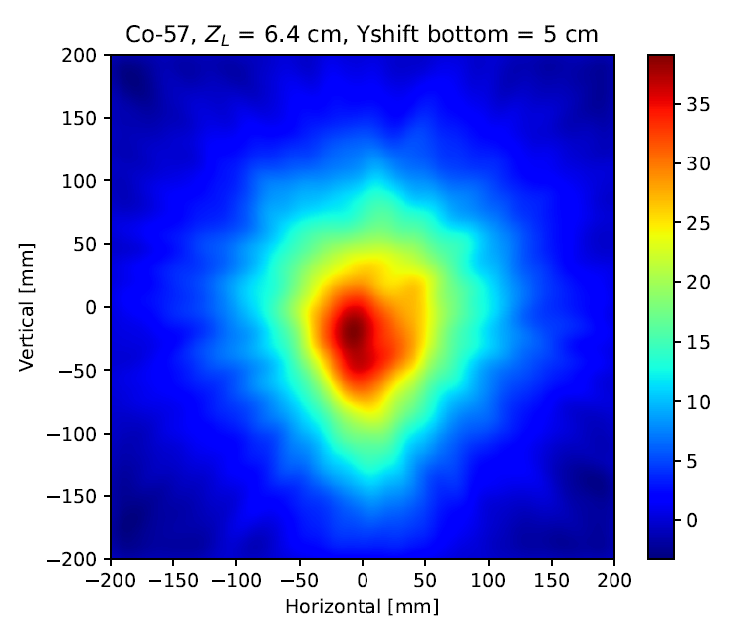


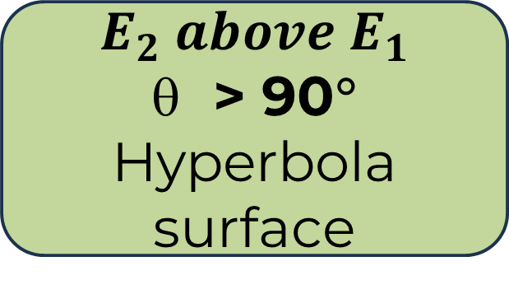
$$E_{2} above E_{1}$$
> 90°
Hyperbola surface
$$XRF not$$
$$being filtered$$
$$Energy cut$$
$$criteria$$

