Slide 1
Probabilistic Approach of Solving Burnup problems.
K. A. Bala¹, M R Omar¹,
¹School of Physics, Universiti Sains Malaysia
iNuSTEC2023 | 10 October 2023

Slide 2
Outlines
Introduction
Theoretical Background
i. Bateman equations
Probabilistic Method
Approximation order
Sample Calculations
i. Sample 1
ii. Sample 2
iii. Sample 3
5. Conclusions

Slide 3
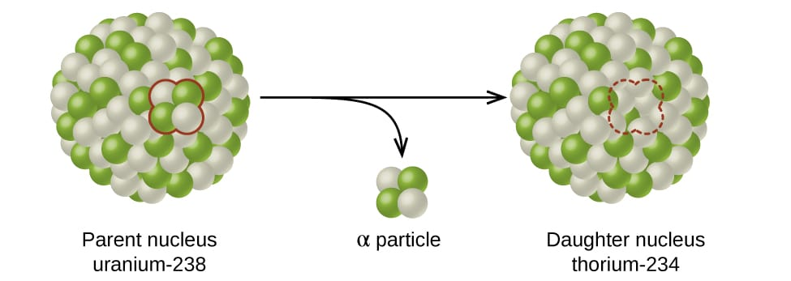
Introduction
Nuclear Transmutations
By Decay
By fission and
fusion, etc.

Slide 4
Introduction (cont.)
Burnup equation
$\frac{dy}{dt}=A.y$ (1)
Or in a compact matrix form
$y_{\left(t\right)}=e^{At}. y_{\left(o\right)}$ (2)
where, $y_{\left(t\right)}$ Is the future concentrations of nuclides involved in the calculation at a particular time, And $y_{\left(o\right)}$ Is the initial concentrations of nuclides at t=0sec while $e^{At}$ Is the matrix exponential.

Slide 5
Introduction (cont.)
Challenges
Determining a simple and reliable algorithm of solving stiff burnup problems
Finding the matrix exponential in Eq. (2) is not easy
Traditional Method
Chebyshev rational approximation method (CRAM)
Taylor series, etc
Both use matrix exponential
New method – Probabilistic method
Advantage of new method: free from matrix exponential

Slide 6
Probabilistic Method
Generally, the concentration of nuclides i at a given time $t+∆t$, is contributed by two factors.
Firstly, it is contributed by the un-reacted nuclides i within the interval $(t, t+∆t)$.
Secondly, it is contributed by the transmutation of other nuclides that occur within the interval $(t, t+∆t)$, which leads to the production of nuclide i. Therefore, the concentration of nuclide i after the next sub-step, $t+∆t$ , can be expressed as,
.

Slide 7
Probabilistic Method (cont.)
$${ y}_{i}(t+∆t)=π_{i→i}y_{i}(t)+\sum_{∀l≠i}{π_{l→i}y_{l}\left(t\right) (3)}$$
where$π_{l→i}≡π_{i,0}$ is the probability of nuclide i not undergoing a transmutation event; $π_{l→i}$ Is the probability of any nuclides l undergoing a transmutation event that transforms themselves into nuclide i . By definition,
$${ π}_{l→i}=\sum_{∀j∈𝓡}{π_{j (4) }}$$
Notes:
Add references.

Slide 8
Probabilistic Method (cont.)
Repository of the C++ code that implements the Probabilistic Approach: https://github.com/rabieomar92/cnuctran, we give comprehensive information on the new methodology

Slide 9
Sample Calculations
Simulation was done by CNUCTRAN and compared the results against Chebyshev Rational Approximation Method of order 48 (CRAM48).
The nuclides data, such as the half-lives and other transmutation chains of over 4000 nuclides, are fetched from an XML file provided by ENDF, Table 1 provide the summary of the sample calculations.
Notes:
Add references.

Slide 10
Table 1: Sample Calculations
Sample | Total Nuclides | Nuclides Involved | Initial Concentrations (mol) | Reaction rates | Time Step (sec)
1 | 1489 (150,250) | U-235, U-2380 | U-235: 0.1, U-238: 0.9 | (n, a:1E-4, n, gamma:1E-4, fission:1E-5) | 8.64E4
2 | 1603 (150,264) | U-235, U-238 | U-235: 0.1, U-238: 0.9 | (n, a:1E-4, n, gamma:1E-4, fission:1E-5) | 8.64E6
3 | 1632 (137,237) | Np-237 | Np-237: 1.0 | Pure Decay | 1E13
Notes:
Add references.

Slide 11
Sample 1
Figure 1: Relative error versus sample 1 after $8.64×{10}^{4}sec$
The results obtained show 224 nuclides with non-zero concentration. 16 nuclides with negative CRAM concentration, and these nuclides have a zero concentration on CNUCTRAN. 1249 nuclides with both zero CRAM and CNUCTRAN concentration.
Notes:
Add references.

Slide 12
fig 1 of Sample 1 (cont.)
Notes:
Add references.

Slide 13
Sample 2
Figure 2: Relative error versus sample II after $8.64×{10}^{6}sec$.
the results obtained show 224 nuclides with non-zero concentration. 25 nuclides with negative CRAM concentration, and these nuclides have zero concentration on CNUCTRAN. 1354 nuclides with zero concentration on both two methods.
Notes:
Add references.

Slide 14
Fig 2 of sample 2 (cont.)
Notes:
Add references.

Slide 15
Sample 3
Figure 3: Relative error versus sample III after $1×{10}^{13}sec$
The results obtained show 15 nuclides with non-zero concentration. 1617 nuclides with both zero CRAM and CNUCTRAN concentration.
Notes:
Add references.

Slide 16
Fig 3 of sample 3 (Cont.)
Notes:
Add references.

Slide 17
Table 2: CPU Time Comparison
Time step, t | CPU Time (CNUCTRAN @2.20GHz,2cores) | CPU Time (CRAM, @2.20GHz,2cores)
$$8.64×{10}^{4}sec$$ | 1.274 | 0.781
$$8.64×{10}^{6}sec$$ | 1.294 | 0.828
$$1×{10}^{13}sec$$ | 1.200 | 0.672
Notes:
Add references.

Slide 18
Conclusions
Previously, the probability distribution of transmutation events is used.
This work used CNUCTRAN .
The numerical results for various burnup problems demonstrate the accuracy and efficiency of the probabilistic method, making it a promising alternative for simulating realistic nuclear transmutations.
Notes:
Add references.

Slide 19
References
[1] ‘bateman 1910’.
[2] O. Calvin, S. Schunert, and B. Ganapol, ‘Global error analysis of the Chebyshev rational approximation method’, Ann Nucl Energy, vol. 150, Jan. 2021, doi: 10.1016/j.anucene.2020.107828.
[3] J. Cetnar, P. Stanisz, and M. Oettingen, ‘Linear chain method for numerical modelling of burnup systems’, Energies (Basel), vol. 14, no. 6, 2021, doi: 10.3390/en14061520.
[4] A. E. Isotalo and P. A. Aarnio, ‘Comparison of depletion algorithms for large systems of nuclides’, Ann Nucl Energy, vol. 38, no. 2–3, pp. 261–268, Feb. 2011, doi: 10.1016/j.anucene.2010.10.019.
[5] M. R. Omar and J. A. Karim, ‘The probability distribution of transmutation events and its application for solving burnup problems’, Progress in Nuclear Energy, vol. 152, Oct. 2022, doi: 10.1016/j.pnucene.2022.104395.
[6] Y. Cai, X. Peng, Q. Li, L. Du, and L. Yang, ‘Solving point burnup equations by Magnus method’, Nuclear Engineering and Technology, vol. 51, no. 4, pp. 949–953, Jul. 2019, doi: 10.1016/j.net.2019.01.006.
[7] E. Tavakkoli, M. Zangian, A. Minuchehr, and A. Zolfaghari, ‘Development and validation of ISOBURN, a new depletion code’, Ann Nucl Energy, vol. 159, p. 108319, 2021, doi: 10.1016/j.anucene.2021.108319.
[8] D. M. Gordon, ‘A Survey of Fast Exponentiation Methods’, 1998.
[9] F. G. Gustavson, ‘Two Fast Algorithms for Sparse Matrices: Multiplication and Permuted Transposition’, ACM Transactions on Mathematical Software (TOMS), vol. 4, no. 3, pp. 250–269, 1978, doi: 10.1145/355791.355796.
Notes:
Add references.

Slide 20
Acknowledgements
The authors wish to express their gratitude to Universiti Sains Malaysia for financing this research The Fundamental Research Grant scheme, no. FRGS/1/2022/STG07/USM/02/09.
Notes:
Add references.

Slide 21
Thank You

