Slide 1
Study the Dynamic Aperture of a Compact Hadron Driver for Cancer Therapy Leo Kwee Wah_{a}, K. Takayama_{b,c,d,e}, T. Adachi_{b,c}, T. Kawakubo_{b} and T. Dixit_{f} ªMalaysian Nuclear Agency, Bangi, 43000 Kajang. Selangor. Malaysia. ^{b}High Energy Accelerator Research Organization (KEK), Tsukuba, Ibaraki, Japan. ^{c}The Graduate University for Advanced Studies (SOKENDAI), Tsukuba, Ibaraki, Japan. ^{d}Tokyo Institute of Technology, Nagatsuda, Kanagawa, Japan. ^{e}Tokyo City University, Setagaya, Tokyo, Japan. ^{f}Society for Applied Microwave Electronics Engineering & Research (SAMEER), Mumbai, India.

Slide 2
Outline
Hadron Driver
Lattice Requirements
Lattice Parameters
Simulation
Results and Discussion
Conclusion

Slide 3
Hadron
Driver

Slide 4
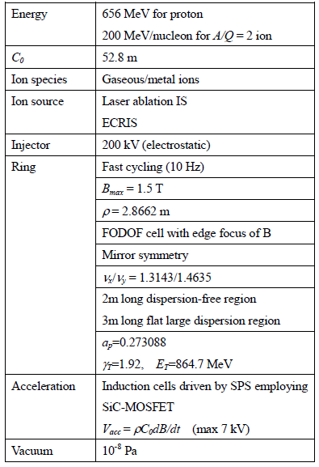
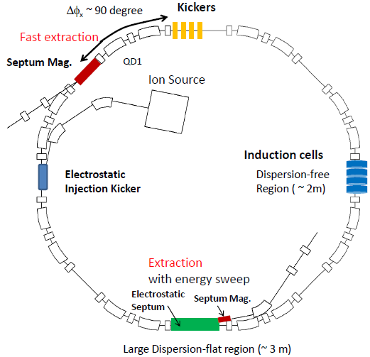
Dedicated Hadron Driver System
Cell A
Fast extraction
Septum mag.
Cell B
Cell B
Cell A

Slide 5
Lattice Parameters

Slide 6
Lattice Parameters
Cell-1
Cell-2
QF1
QF1
QF2
QF2
D1
D2
BM
D2
D2
BM
D2
D1
D3
D2
BM
D2
D2
BM
D2
D3
QD1
QD2
Configuration =Cell-1 X Cell-2 X Drift Space 4 X Cell-1 X Cell-2
Drift Space 4 = Free Dispersion Region
A/Z=2, Energy = 200 MeV/U
Total length of 25.6 m and 26.4* m
Drift Space | S [m]
D1 | 1.5
D2 | 0.3
D3 | 0.1/0.5*
D4 | 1.8/1.0*
Bending Magnet, B[T] | Bending Angle, Θ[⁰] | Edge Angle, Θ[⁰] | Curvature, ρ [m] | Magnet Length, l_{B} [m]
BM (1.5) | 22.5 | 11.25 | 2.8662 | 1.1256
Quad Magnet | Length, l_{Q}[m] | K-Value [m⁻²]
QF1 | 0.30 | Optimized
QD1 | 0.30 | Optimized
QF2 | 0.30 | Optimized
QD2 | 0.30 | Optimized
Two cases will be evaluated
*Case B

Slide 7
Basic Formula of Transfer Matrix
$$M_{D}=\left(\begin{matrix}1 & ℓ \\ 0 & 1\end{matrix}\right)$$
$${ M}_{B}= \left(\begin{matrix}\cos{θ} & ρ\sin{θ} \\ −\frac{\sin{θ}}{ρ} & \cos{θ}\end{matrix}\right)$$
$${ M}_{HE}= \left(\begin{matrix}1 & 0 \\ \frac{\tan{ε}}{ρ} & 1\end{matrix}\right)$$
$${ M}_{VE}= \left(\begin{matrix}1 & 0 \\ 1/ρ\left(b/{6ρ\cos{ε}}−\tan{ε}\right) & 1\end{matrix}\right)$$
$${ M}_{d}=\left(\begin{matrix}\cos{\sqrt{K_{D}}}ℓ_{Q_{D}} & \frac{\sin{\sqrt{K_{D}}}ℓ_{Q_{D}}}{\sqrt{K_{D}}} \\ −\sqrt{K_{D}}\sin{\sqrt{K_{D}}}ℓ_{Q_{D}} & \cos{\sqrt{K_{D}}}ℓ_{Q_{D}}\end{matrix}\right)$$
$$M_{f}=\left(\begin{matrix}\cosh{\sqrt{K_{F}}}ℓ_{Q_{F}} & \frac{\sinh{\sqrt{K_{F}}}ℓ_{Q_{F}}}{\sqrt{K_{F}}} \\ \sqrt{K_{F}}\sinh{\sqrt{K_{F}}}ℓ_{Q_{F}} & \cosh{\sqrt{K_{F}}}ℓ_{Q_{F}}\end{matrix}\right)$$
Drift space,
Bending magnet,
Horizontal edge effect of bending magnet,
Vertical edge effect of bending magnet,
Defocusing Quadrupole,
Focusing Quadrupole,
Whereby:
$θ={Bending angle of bending magnet}$
$$ρ=Curvature of of bending magnet$$
$$ε={Edge angle of bending magnet}$$
$$b=\text{Distance} \text{over} \text{which} \text{the} \text{fringe} \text{field} \text{drops} \text{to} \text{zero} \text{of} \text{bending} \text{magnet}$$
$$K_{D,F}={K−value of the related magnets }$$
$${ℓ or ℓ}_{Q_{D,F}} =Length of the related space or magnets$$
$$K=\frac{B′}{Bρ}$$

Slide 8
Simulation

Slide 9
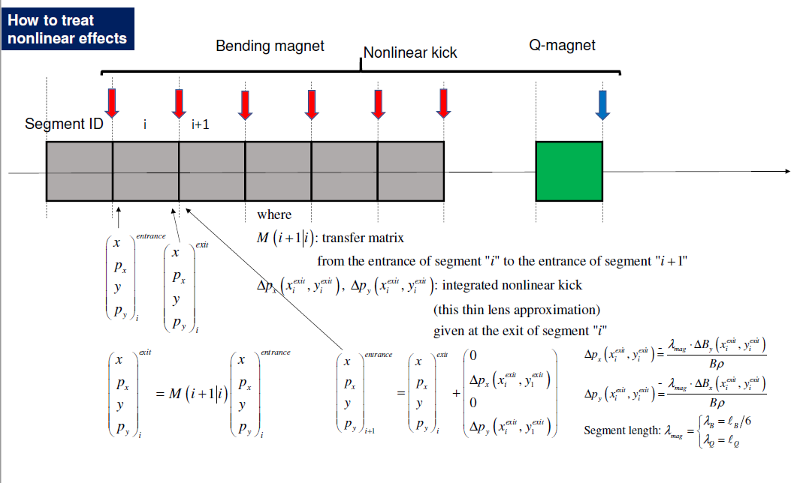
Tracking Model
No. | Type of Magnets | Number of Magnets | Number of kicks
1 | Bending magnet | 16 | 96
2 | Quadrupole magnet | 20 | 20

Slide 10
Tracking Procedure
Define the initial ditsribtuiton and parameters of the particles
Define the transfer matrices of magnets and perturbation term
Particles tracking along the ring
Phase space plotting of the particles with seelcted turns and location

Slide 11
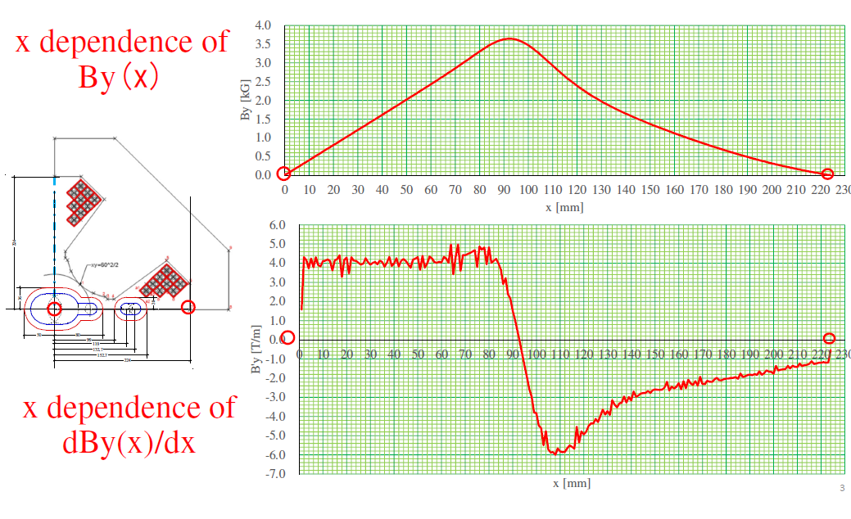
Simulation of Quadrupole Magnet

Slide 12
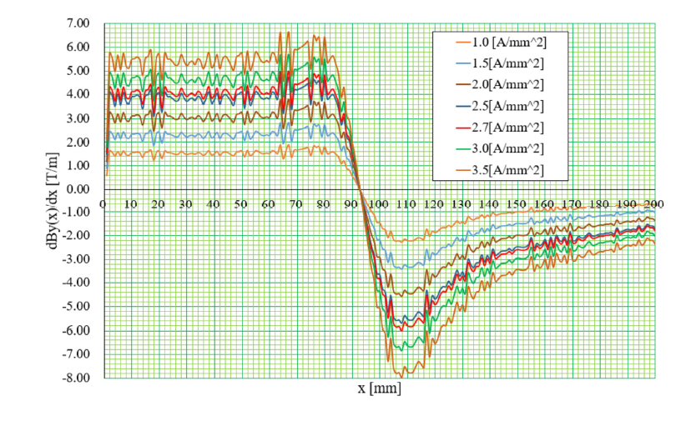
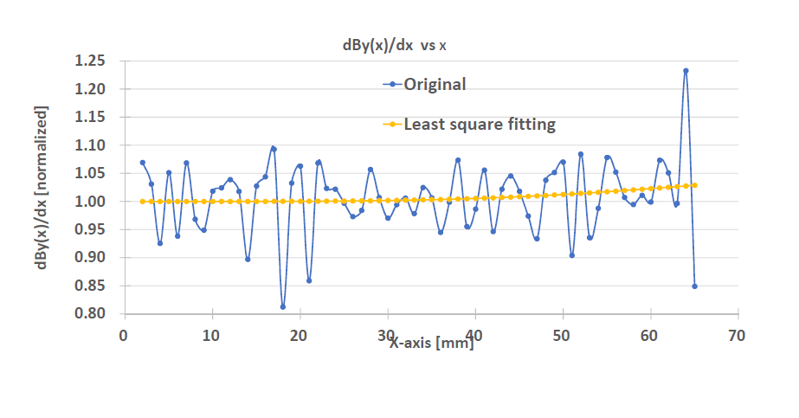
Quadrupole Magnet With Fitting

Slide 13
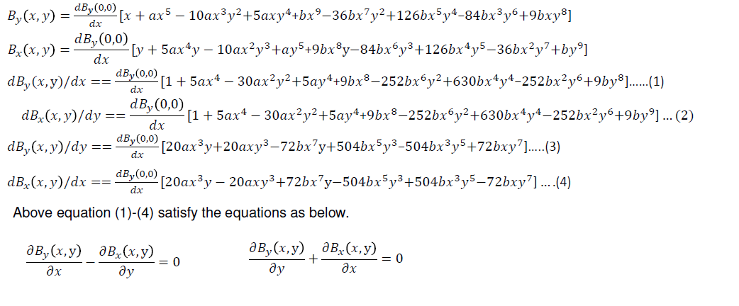
Quadrupole Magnet (With 12 poles field and 20 Poles field)
a and b = Constant coefficient of the polynomial function determined by the least square fitting method for the non-linear term of the magnet simulation
Case | Horizontal initial distribution | Vertical initial distribution | a_{b} [m⁻²] | b_{b} [m⁻⁴] | a_{Q} [m⁻⁴] | b_{Q} [m⁻⁸]
1 | 0.04, 0 | 0.01 -0.04 | 6.2010 X 10⁻² | 5.5620 X 10¹ | 4.4068 X 10² | -3.6857 X 10⁶
2 | 0.04, 0 | 0.01 -0.04 | 6.2010 X 10⁻²/4 | 5.5620 X 10¹/4 | 4.4068 X 10²/4 | -3.6857 X 10⁶/4
3 | 0.04, 0 | 0.01 -0.04 | 6.2010 X 10⁻²/8 | 5.5620 X 10¹/8 | 4.4068 X 10²/8 | -3.6857 X 10⁶/8

Slide 14
Results and
Discussion

Slide 15
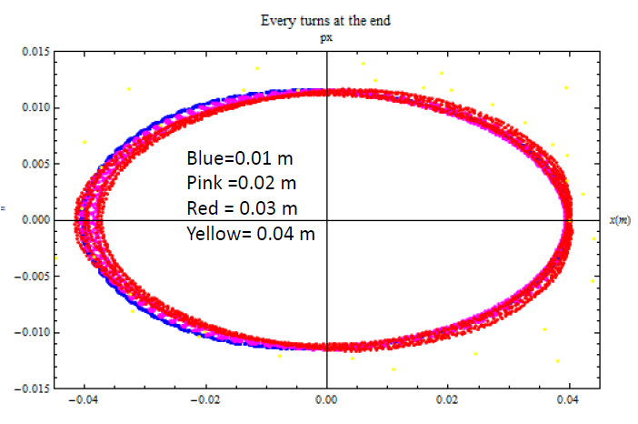
Tracking Result: Case 1
Horizontal phase space at end of the ring

Slide 16
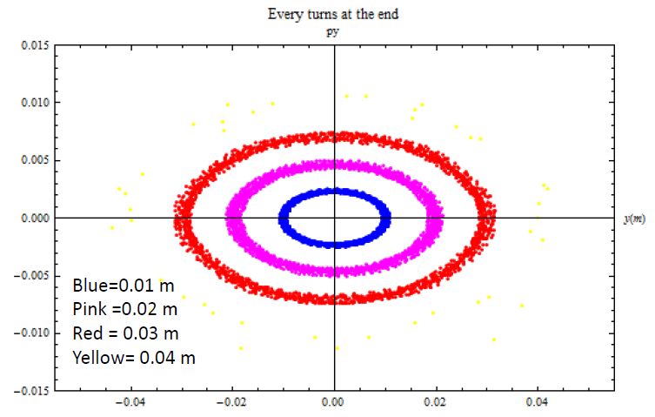
Tracking Result: Case 1
Vertical phase space at end of the ring

Slide 17
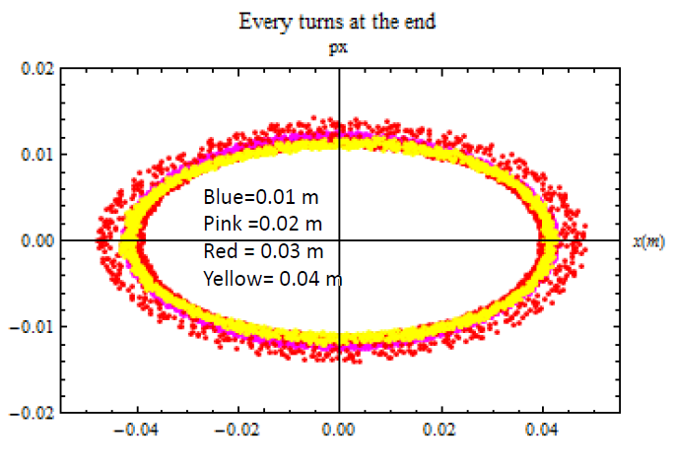
Tracking Result: Case 2
Horizontal phase space at end of the ring

Slide 18
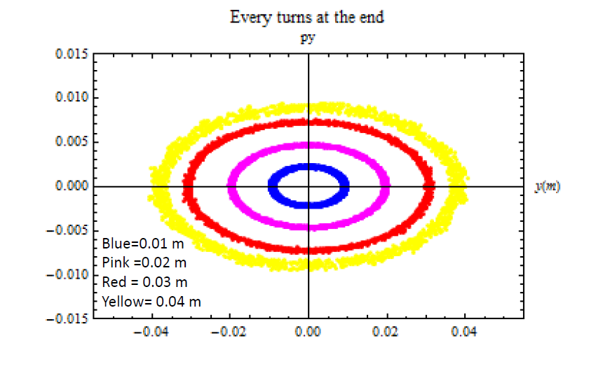
Tracking Result: Case 2
Vertical phase space at end of the ring

Slide 19
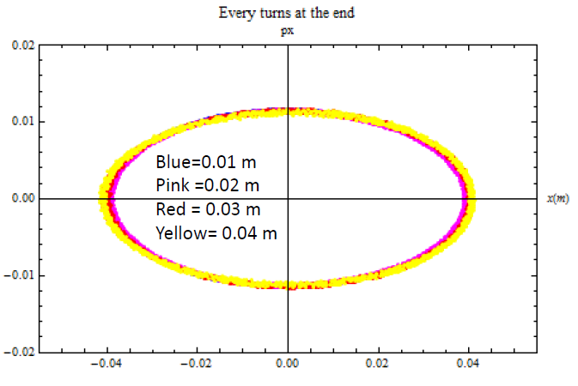
Tracking Result: Case 3
Horizontal phase space at end of the ring

Slide 20
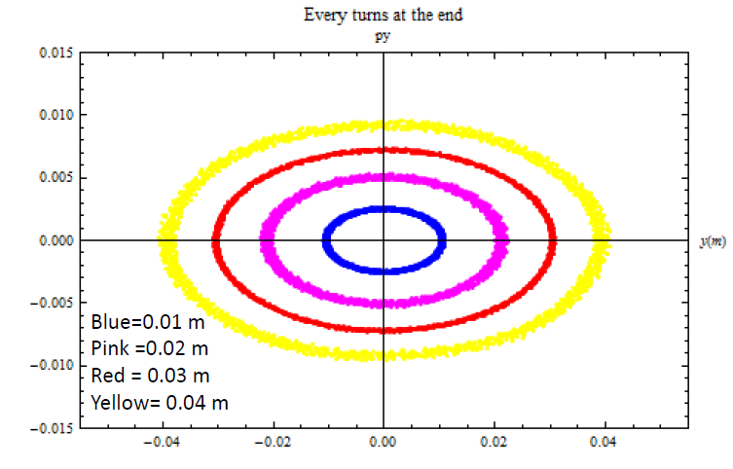
Tracking Result: Case 3
Vertical phase space at end of the ring

Slide 21
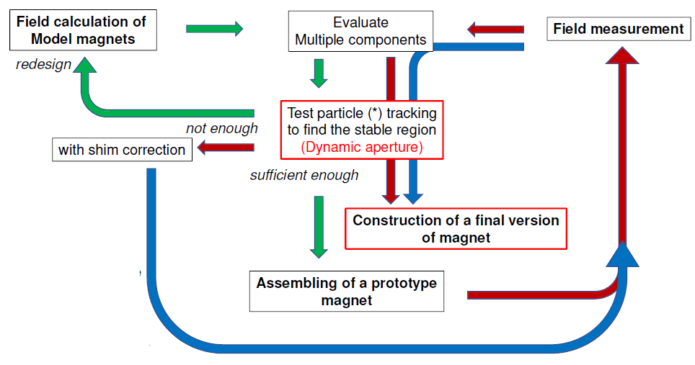
Discussion
Case | a_{b} [m⁻²] | b_{b} [m⁻⁴] | a_{Q} [m⁻⁴] | b_{Q} [m⁻⁸] | Stable Region X & Y [m]
1 | 6.2010 X 10⁻² | 5.5620 X 10¹ | 4.4068 X 10² | -3.6857 X 10⁶ | ~ 0.01
2 | 6.2010 X 10⁻²/4 | 5.5620 X 10¹/4 | 4.4068 X 10²/4 | -3.6857 X 10⁶/4 | ~ 0.02
3 | 6.2010 X 10⁻²/8 | 5.5620 X 10¹/8 | 4.4068 X 10²/8 | -3.6857 X 10⁶/8 | ~ 0.04

Slide 22
Conclusion
Approach of dynamic aperture is introduced with its evaluation.
The magnets design is essential to achieve much larger stable region and ensure the energetic beam able to delivery to the user facility.
In near future, the magnets need to be redesign and dynamic aperture of the ring must be evaluated again.

Slide 23
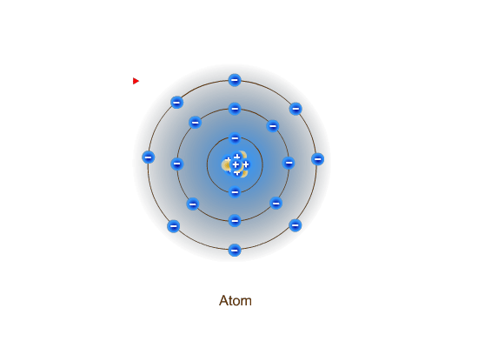
THANK YOU

